Slide 1

VIETNAMESE STUDY SYSTEM FOR JAPANESE

Slide 2


Nguyen Van Sang
指導教員 Supervisor
01
02
03
04
05
06
MinhNN
PM
DuyNT
チームのメンバー
LinhNH
チームのメンバー
TungDT
チームのメンバー
QuanNH
チームのメンバー
ThangPD
チームのメンバー
ABOUT US - 私達について

Slide 3
アウトライン OUTLINE
01
導入 Introduction
02
プロジェクト管理 Project Management
03
ソフトウェア要求仕様 Software Requirement Specification
04
ソフトウェア設計説明書 Software Design Description
05
品質管理 Quality Control
06
プロジェクト結果 Project Result
07
デモ Demo
08
質問と回答 Q & A

Slide 4
現在状況
Current Situation
01
02
在のウェブサイト Existing Websites
導入
1. Introduction
アイデア
Idea
03
04
提案
Proposal
内容 Content

Slide 5

1.1. 現在状況 Current Situation
Vietnam is nation attract foreign labor candidates
More adapted to life in Vietnam
BUT
Vietnamese is not common in the world
It's a complex language
No many sites for Japanese people to learn Vietnamese.
導入 Introduction

Slide 6
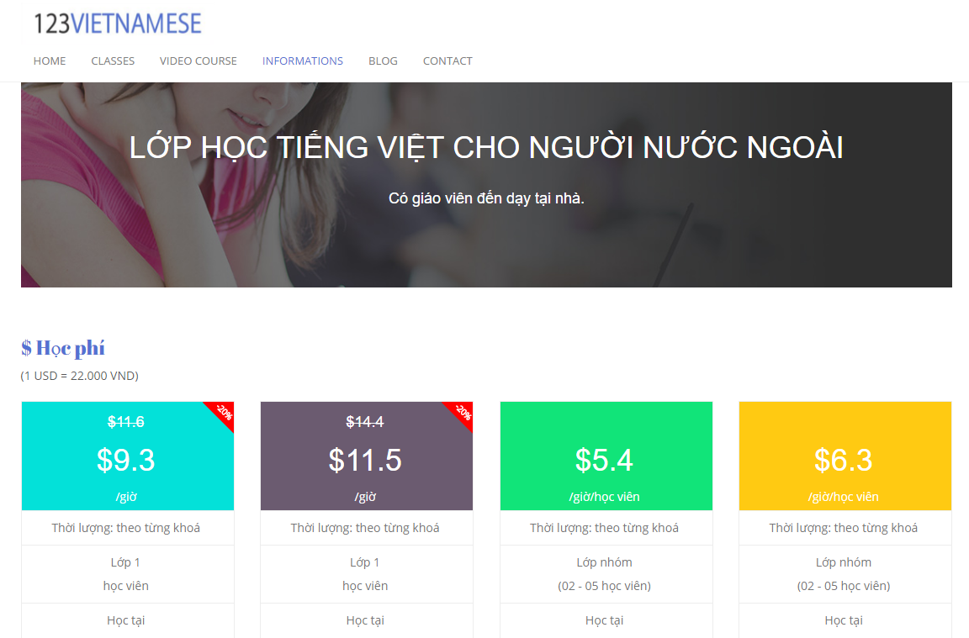
1.2.在のウェブサイト Existing Websites
123VIETNAMESE is a Vietnamese language training center that was founded in 2010 by a teacher group from Hanoi University of Education and University of Languages & International Studies.
123vietnamese.com
Advantages:
The website supports user in studying through video call with lecture, which is flexible in time for students.
The diverse online lessons are classified based on level of difficulty and purposes (for academy, research or travelling).
Disadvantages:
The website charges course fee.
導入 Introduction

Slide 7
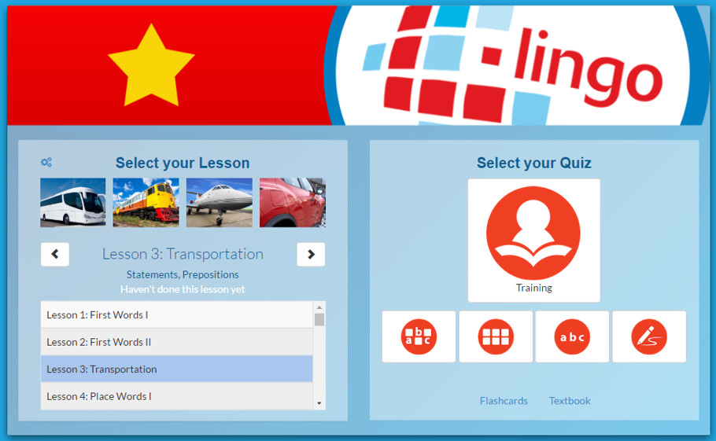
1.2.在のウェブサイト Existing Websites
l-lingo is a website helping users study 20 Asian & European languages including Vietnamese.
Advantages:
The themes of lessons are very diverse.
The website uses words, images and sound clips of native speakers, which is very convenient for users to study vocabulary and practice listening.
The website including quiz section at each lesson to help user review
Disadvantages:
The website focuses mostly on teaching vocabulary related to themes. There is no grammar section in each lesson.
The number of free lessons is limited. Users have to register and log in in order to continue studying
導入 Introduction

Slide 8
1.3. アイデア Idea
With original basic features such as lessons, small tests
A free website for studying Vietnamese
Convenient features for users.
Suitable for everyone, from beginner
導入 Introduction

Slide 9

1.4. 提案 Proposal
Release a website supporting users in study Vietnamese
After logging in the system, user can see their progress of study and skills accessments
Offers users almost of main features without registration
User can send report to Editor about the contents of the website
Support Japanese
Users can enlarge knowledge about Vietnamese for all skills
Supports for the most used browser like Internet Explorer, Firefox or Chrome
Used technologies such as Java, SpringMVC, AngularJS framework, Bootstrap, Hibernate
導入 Introduction

Slide 10

プロジェクト管理 Project Management
01
プロジェクト組織
Project Organization
ソフトウェ アプロセス モデル
Software Process Model
02
03
プロジェクト計画
Project Schedule
目標 と 成果物
Objectives & deliverables
04
05
ツールと インフラストラクチャ
Tools & Infrastructure
リスク管理
Risks management
06
07
コンフィグレーション管理
Configuration management
コミュニケーション管理
Communication management
08
内容 Content

Slide 11
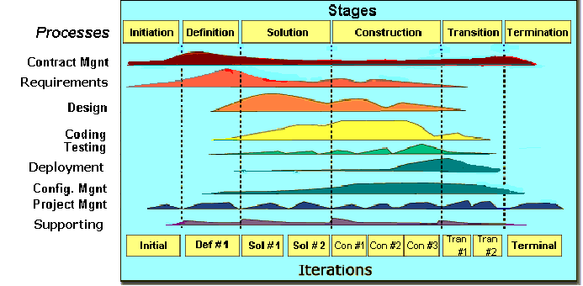
2.1. ソフトウェ アプロセス モデル Software Process Model
Initiation phase
Definition phase
Solution phase
Construction phase
Transition
Termination
FPT Software process model
プロジェクト管理 Project Management

Slide 12
2.1. ソフトウェ アプロセス モデル Software Process Model
Initiation | Identify business functions of the system Determining the scope, conditions and limitations of the project List the main functions of the system List one or more suitable architecture for the system Identify project risks Complete Report #1, and Report #2
Solution | Complete SRS Design Architecture and Database Document Complete Report #3, Report #4
Construction | Complete Coding and Testing Manage resource and control operations to optimize cost, time and quality. Complete software packages and Report #5, Report #6
Termination | Preparing presentation Complete Project
プロジェクト管理 Project Management

Slide 13
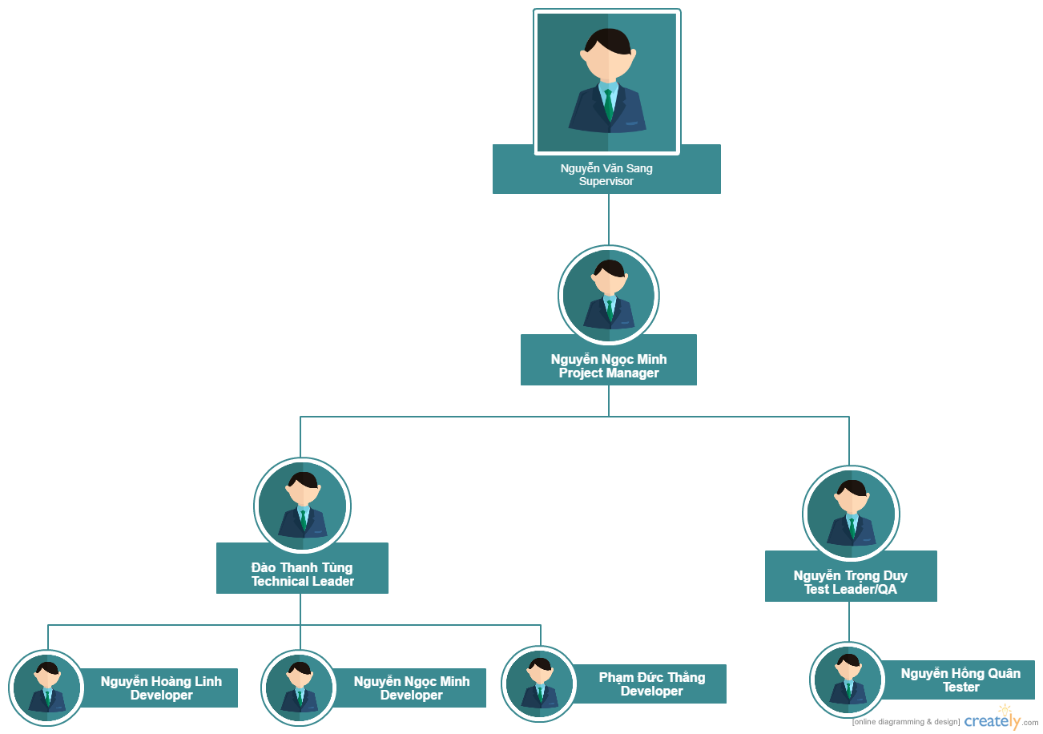
2.2. プロジェクト組織 Project Organization
Veazy Organization
プロジェクト管理 Project Management

Slide 14
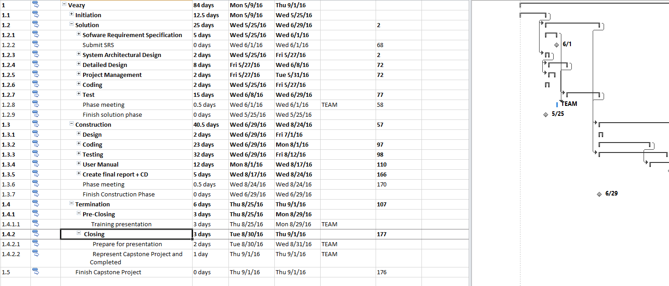
2.3. プロジェクト計画 Project Schedule
プロジェクト管理 Project Management

Slide 15
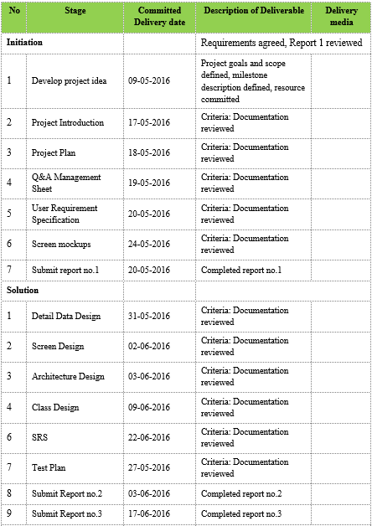
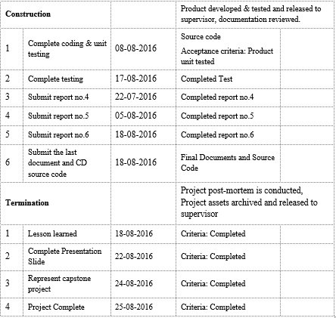
2.4. 目標 と 成果物 Objectives & deliverables
プロジェクト管理 Project Management

Slide 16













2.5. ツールと インフラストラクチャ Tools & Infrastructure
プロジェクト管理にツール Tools for project management
開発にツール Tools for developing
プロジェクト管理 Project Management

Slide 17
2.6. リスク管理 Risks management
Risk ID | Risk Category | Risk Source | Risk Description | Probability | Impact | Exposure | Priority | Trigger | Risk Status | Last updated date | Mitigation | Contigency | Person in charge | Planned end date | Mitigation Cost | Mitigation Benefit | Actual end date | Action Status
R01 | Human resource | Insufficient PM Experience | Unrealistic schedules | 0.8 | 8 | 6.4 | 8 | Deliverables are over 50% late when meet the deadlines | Open |  | PM needs to prepare knowledge and learn from other PMs' experience | PM needs to ask support form the supervisor. | PM | 8/25/2016 |  |  | 8/25/2016
R02 | Project Requirement | Too many requirement changes | SRS has been changed too frequently | 0.3 | 6 | 1.8 | 6 | SRS has been changed over 10 times a week after SRS was approved. | Open |  | Clear out the requirements and members' abilities at the beginning of the project | Pending all change requests, have meeting to clear the requirements again | PM | 8/24/2016 |  |  | 8/29/2016
R03 | Human resource | Shortage of Human resource | Lack of team members | 0.3 | 4 | 1.2 | 4 | Member leaves the project team | Open |  | Have an open talk within team member to clear out the objectives and understand each others. | Assign work to other members, increase effort | PM | 8/24/2016 |  |  | 8/25/2016
プロジェクト管理 Project Management

Slide 18
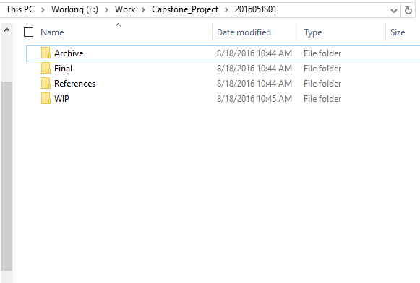
2.7. コンフィグレーション管理 Configuration management
Final: Store sent and delivered documents
References: Store reference documents. For example: templates, technologies document, etc.
WIP: Store documents in progress developing
Plans: Plan of capstone project
Users: Working Folder of Member
Documents: Store whole documents in progress developing
Records: Store documents like Meeting Minutes, Q & A Management, etc.
プロジェクト管理 Project Management

Slide 19
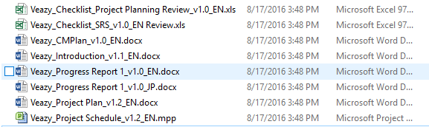
2.7. コンフィグレーション管理 Configuration management
Rule: ProjectCode_Document’s name_v<x.x>_language
ProjectCode: Veazy
Document’s name: CMPlan, Introduction, Project Plan, etc.
v<x.x>: document’s version. For example: v1.0, v1.1, v1.2, etc.
Language:
English
Japanese
Naming conventions
プロジェクト管理 Project Management

Slide 20
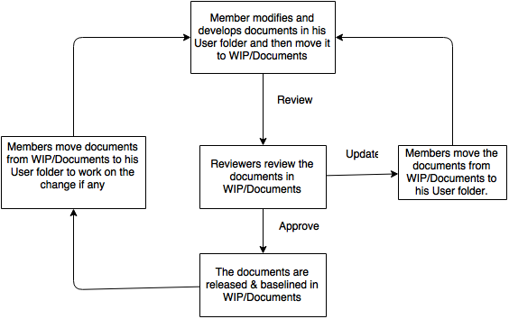
2.7. コンフィグレーション管理 Configuration management
プロジェクト管理 Project Management

Slide 21
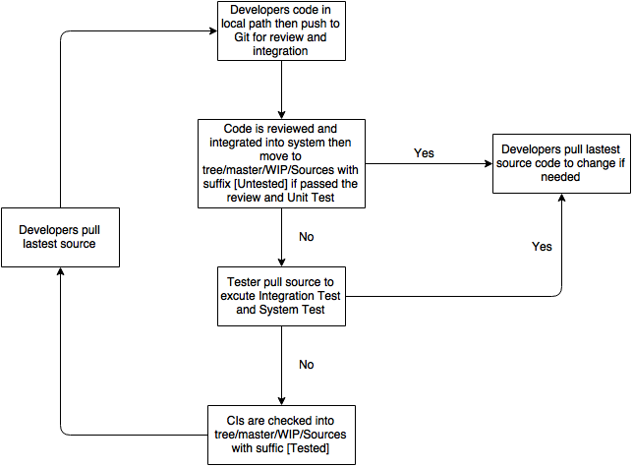
2.7. コンフィグレーション管理 Configuration management
プロジェクト管理 Project Management

Slide 22





2.8. コミュニケーション管理 Communication management
労働時間 : 6時間/日、5日/週 - Time: 6 hours/day, 5 days/week
コミュニケーション Communication:
ミーティング議事録 Meeting minutes:
プロジェクト管理 Project Management

Slide 23
プロジェクト管理
Software Requirement Specification
1
2
システムのユーザ System Users
3
機能要求 Functional Requirements
非機能要求 Non-Functional Requirements
内容 Content

Slide 24






3.1. システムのユーザ System Users
4役者があります - There are 4 actors:
Guest
Member
Content Editor
Administrator
プロジェクト管理 Project Management

Slide 25
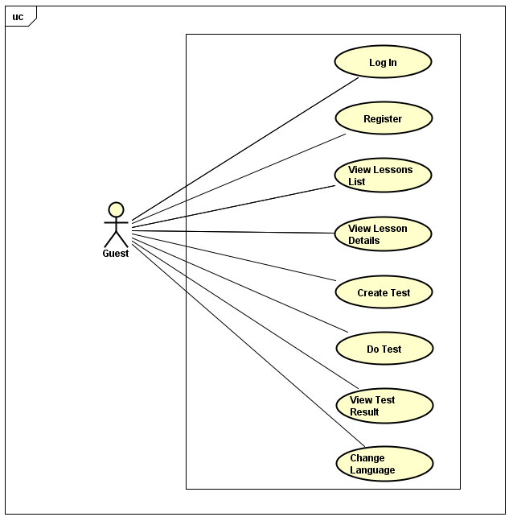
3.2. 機能要求 Functional Requirements
ゲスト GUEST
Guest usecase
プロジェクト管理 Project Management

Slide 26
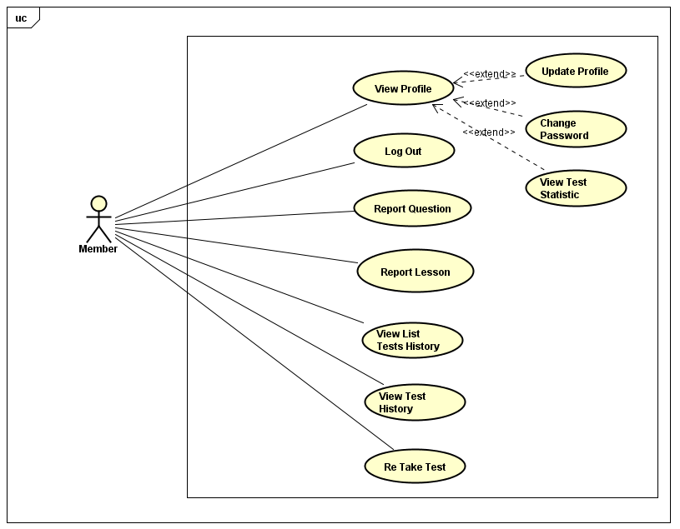
3.2. 機能要求 Functional Requirements
メンバー MEMBER
Member usecase
プロジェクト管理 Project Management

Slide 27
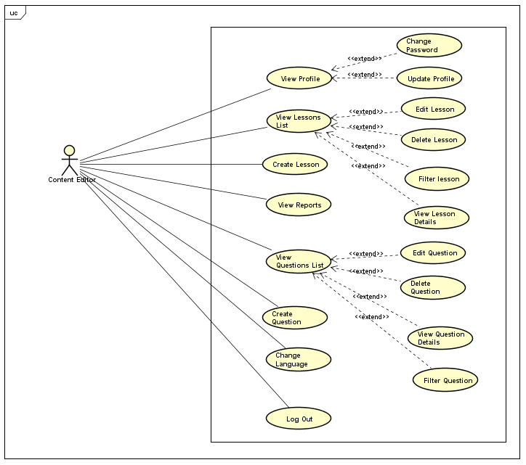
3.2. 機能要求 Functional Requirements
編集者 CONTENT EDITOR
Content Editor usecase
プロジェクト管理 Project Management

Slide 28
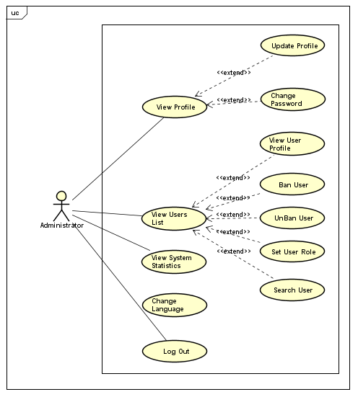
3.2. 機能要求 Functional Requirements
管理者 ADMINISTRATOR
Administrator usecase
プロジェクト管理 Project Management

Slide 29
3.3. 非機能要求 Non-Functional Requirements
Usability:
Interface should be simple, clear, user friendly, easy to learn how to use and easy to remember how to use.
Efficiency of use: each action is taken by no more than 8 steps.
Intuitiveness: the interface is easy to learn and navigate: buttons, headings, and help/error messages are simple to read and understand.
Low perceived workload: the interface appears easy to use, rather than intimidating, demanding and frustrating.
The system should have the flexibility to be can satisfied future changed
The system must meet the requirements for data memory, need to calculate the amount of memory to be able to meet the requirements of the development of the system.
Users need to understand the function of each section to be able to use reasonable discretion and its effectiveness.
プロジェクト管理 Project Management

Slide 30
3.3. 非機能要求 Non-Functional Requirements
Security:
Password of user is md5-hashed before being sent in request to server and saved into database.
Request sent from client is authorize using cookies.
Maintainability & Extensibility:
Strictly follow Java & JavaScript best practices and English-like syntax naming convention in order to help improve readability of source code and keep the Veazy website maintainable in the future.
プロジェクト管理 Project Management

Slide 31
3.3. 非機能要求 Non-Functional Requirements
Performance:
Response time when accessing an action on the system depending on system condition such as number of visitors, access tasks.
Time for loading image, media will be at most 15 seconds and time to progress any function will not exceed 17 seconds.
Supportability:
Web system is written in Java and Bootstrap, easily manage and upgrade and easily connect to database system.
プロジェクト管理 Project Management

Slide 32
ソフトウェア要求仕様
Software Design Description
01
02
03
04
テクノロジー と 理由
Technology & Reason
アーキテクチャ表現
Architecture Representation
パッケージ ビュー
Package View
詳細設計
Detailed Design
内容 Content

Slide 33

4.1. テクノロジー と 理由 Technology & Reason
MVC
Easily manage the complexity of application by dividing the application into three components: model, view and controller.
Better support for TDD.
It is a good support for application built by project team that has many developers and designers but still managed application features.
Veazy system is an incomplete system for now. Veazy is built in the way that towards extensibility and maintainability in the future.
ソフトウェア要求仕様 Software Design Description

Slide 34

4.1. テクノロジー と 理由 Technology & Reason
SpringMVC
Spring provides a very clean division between controllers, JavaBean models, and views.
Spring’s MVC is very flexible, it is entirely based on interfaces.
Spring provides interceptors as well as controllers, making it easy to factor out behavior common to the handling of many requests.
Spring Controllers are configured via IoC. This makes them easy to test, and beautifully integrated with other objects managed by Spring.
No ActionForms. Bind directly to domain objects.
Spring has a well defined interface to business layer.
ソフトウェア要求仕様 Software Design Description

Slide 35

4.1. テクノロジー と 理由 Technology & Reason
HibernateORM
Productivity: It helps developers get rid of writing complex and tedious SQL statement, no more need of JDBC APIs for result set or data handling. It makes developers more concentrate on the business logic and increase the project’s productivity.
Maintainability: It helps reduce the lines of code, makes system more understandable and emphasizes more on business logic rather than persistence work (SQLs).
Portability: It abstracts our application away from the underlying SQL database and sql dialect. Switching to other SQL database requires few changes in Hibernate configuration file.
ソフトウェア要求仕様 Software Design Description

Slide 36

4.1. テクノロジー と 理由 Technology & Reason
AngularJS
Expressive User Interface: Angular employs HTML to define application user interface. HTML carries special attributes explaining which controllers to use for elements.
Less code: By ignoring writing of own pipeline, use of html, simple data model and use of filters, angular makes it coding free for developers.
Testability: AngularJs has been developed keeping in mind the testing process of coding and developing at each and every stage of application development so as to avoid wastage of time.
ソフトウェア要求仕様 Software Design Description

Slide 37
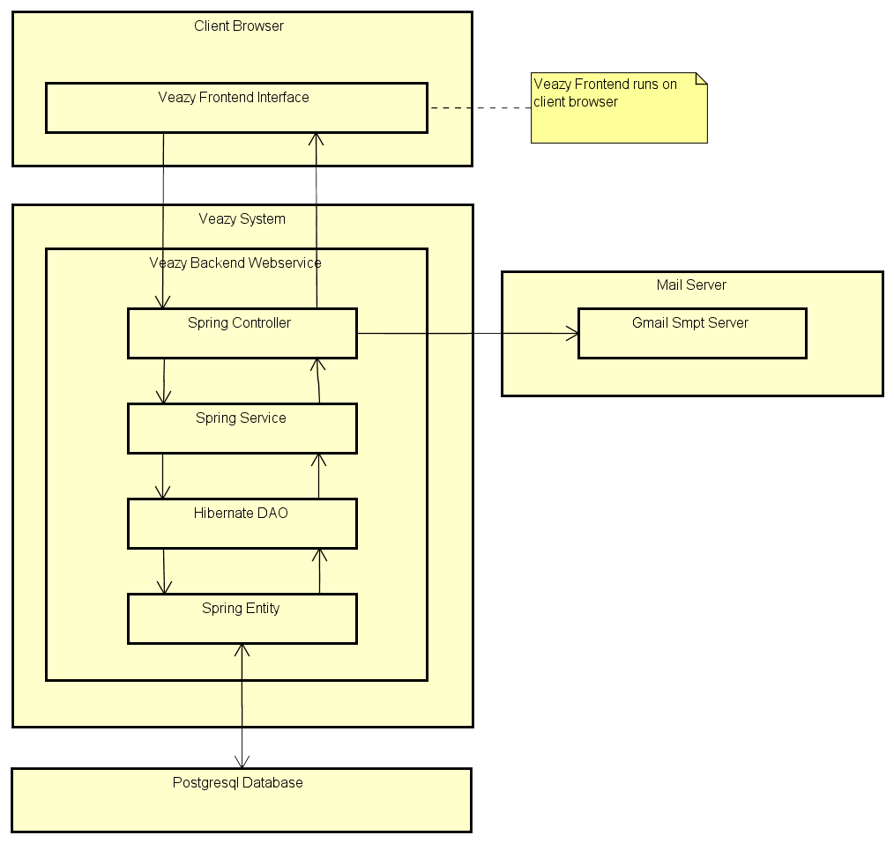
4.2. アーキテクチャ表現 Architecture Representation
Veazy System Overview Architecture
ソフトウェア要求仕様 Software Design Description

Slide 38
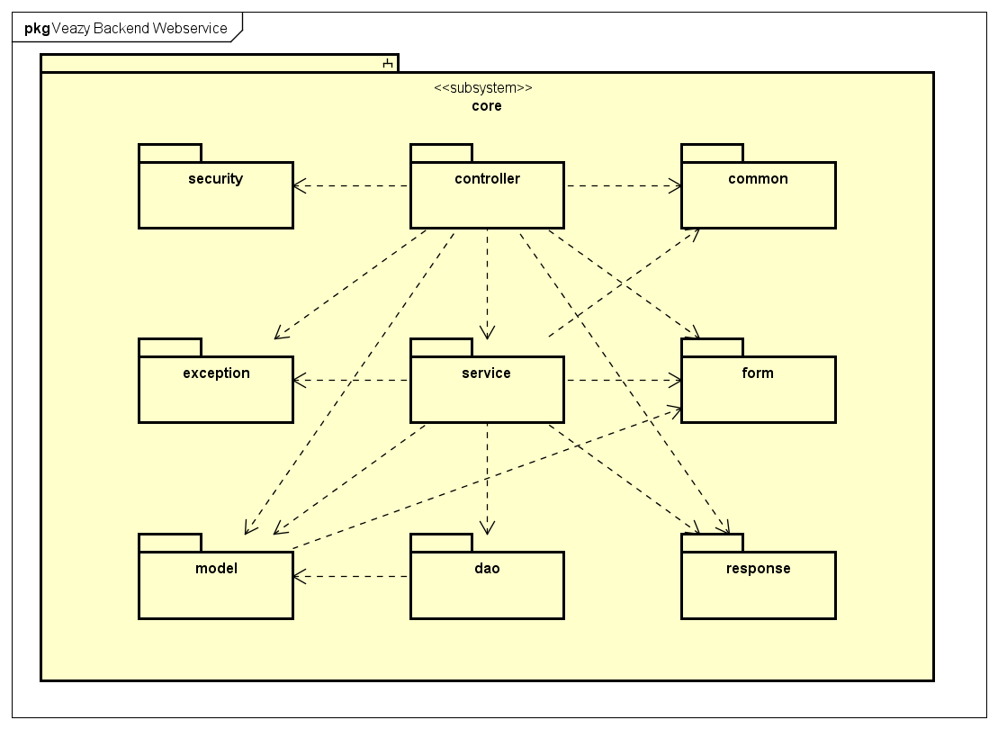
4.3. パッケージ ビュー Package View
Veazy Package Diagram
ソフトウェア要求仕様 Software Design Description

Slide 39
4.4. 詳細設計 Detailed Design
画面フロー Screen flow
ソフトウェア要求仕様 Software Design Description

Slide 40
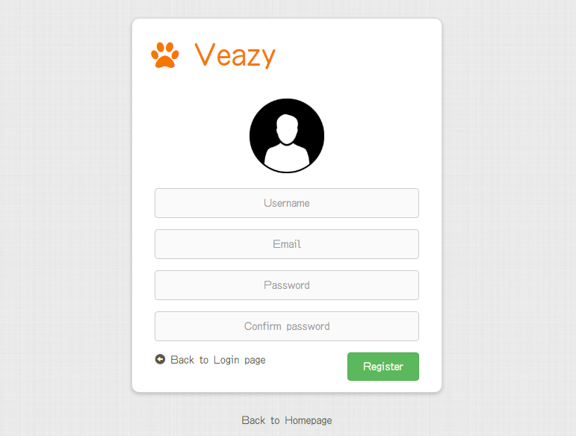
4.4. 詳細設計 Detailed Design
画面設計 Screen design
Field name | Type | Mandatory | Min length | Max length | Description
Username | Textbox | Y | 8 | 30 | Textbox for entering username
Email | Textbox | Y | 6 | 254 | Textbox for entering email
Password | Textbox | Y | 8 | 32 | Textbox for entering password
Confirm Password | Textbox | Y | 8 | 32 | Textbox for re-entering password
Register | Button | Y |  |  | Button to submit register form
Back to Login page | Hyperlink | N |  |  | Hyperlink that redirects to “Login” page
Back to Homepage | Hyperlink | N |  |  | Hyperlink that redirects to “Home” page
Register Screen Design
ソフトウェア要求仕様 Software Design Description

Slide 41
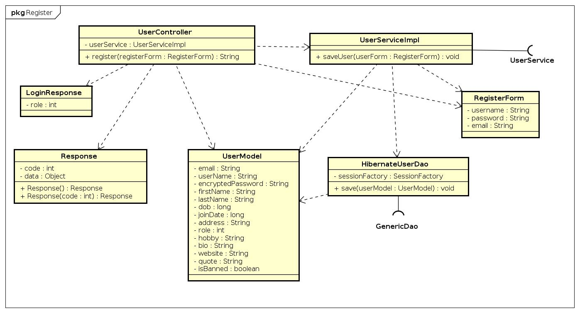
4.4. 詳細設計 Detailed Design
クラス設計 Class Design
Register class diagram
ソフトウェア要求仕様 Software Design Description

Slide 42
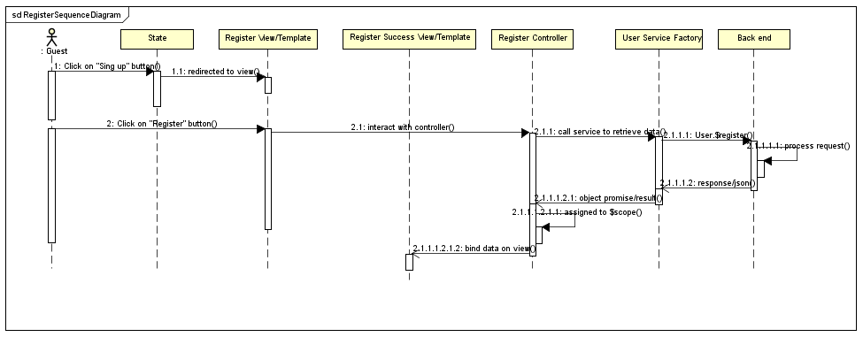
4.4. 詳細設計 Detailed Design
シーケンス線図 Sequence Diagram
Register sequence diagram
ソフトウェア要求仕様 Software Design Description

Slide 43
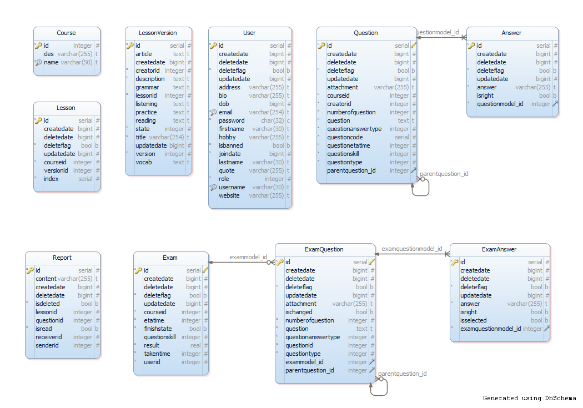
4.4. 詳細設計 Detailed Design
データベース設計 Database Design
ソフトウェア要求仕様 Software Design Description

Slide 44

品質管理
Quality Control

Slide 45
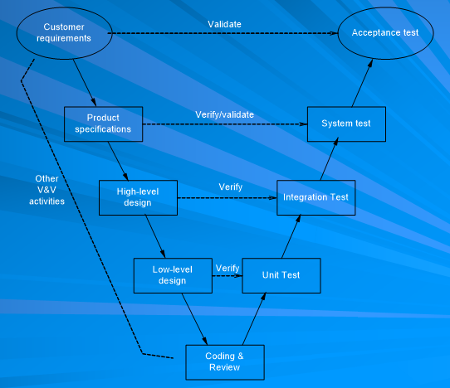
5. 品質管理 Quality Control
Vモデル Model

Slide 46
5. 品質管理 Quality Control
5.1 Review
5.1.2 SRS
5.1.3 Design
5.1.4 Code
5.2 Testing
5.2.1Test Process
5.2.2Test Report
5.1.5 Test Document
5.1.1 Project Plan
内容 Content

Slide 47
5.1. レビュー Review
Question | Yes | No | N/A
Screen design: Does screen designs (if any) satisfy the requirements specified in other documents (SRS, Requirement, Architecture Design) ?
Does it describe GUI of the system as follows:
Does it describe/layout position of all items in GUI? | x
Does it describe processes or actions for GUI? | x
Does it describe relationship between items in GUI and modules or public functions? | x
Are the inputs and outputs for all the interfaces are sufficient and necessary? | x
Class design:
Are there dynamic diagram (sequence, activity diagram) used to describe the complicated method ? | x
Are classes' main interface/methods all clearly described ? | x
Are classes' main attributes all clearly described ? | x
Are all class' general description clearly specified ? | x
Data design:
Have data elements been described in detail with valid value ranges and other data constraints ? | x
品質管理 Quality Control

Slide 48
5.2.1 テストのプロセス Test Process
Base on Project Plan, Project Schedule , SRS to create test plan:
Features to be tested
Acceptance Test Criteria
Environment
Schedules
Responsibilities
Risks and contingencies
1
Create Test Plan
2
Create Test Case
3
Review Test Case
4
Execute Test
5
Log bug
6
Re-test
7
Create Test Report
品質管理 Quality Control

Slide 49
5.2.1 テストのプロセス Test Process
Base on SRS, create test case:
Unit test case
Integration test case
System test case
Acceptance test case
1
Create Test Plan
2
Create Test Case
3
Review Test Case
4
Execute Test
5
Log bug
6
Re-test
7
Create Test Report
品質管理 Quality Control

Slide 50
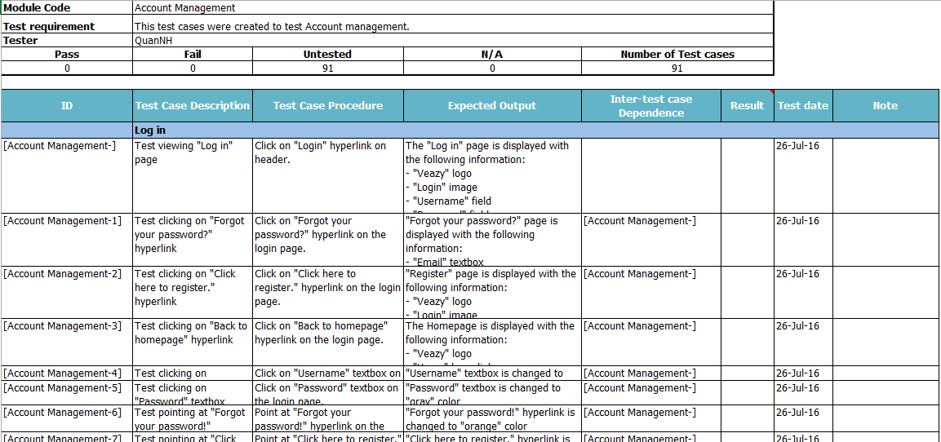
5.2.1 テストのプロセス Test Process
システムテストケース System Test Case
品質管理 Quality Control

Slide 51
5.2.1 テストのプロセス Test Process
Developer self-review:
Unit test case
Tester self-review and peer-review:
Integration test case
System test case
1
Create Test Plan
2
Create Test Case
3
Review Test Case
4
Execute Test
5
Log bug
6
Re-test
7
Create Test Report
品質管理 Quality Control

Slide 52
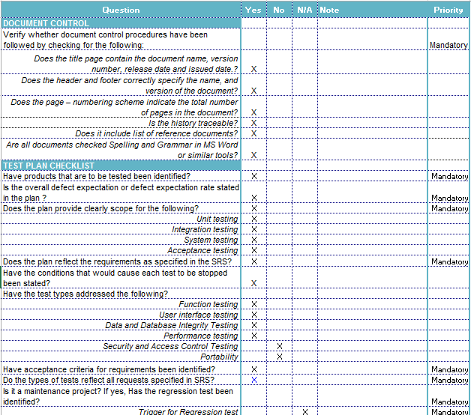
5.2.1 テストのプロセス Test Process
テストレビュー Test case review checklist
品質管理 Quality Control

Slide 53
5.2.1 テストのプロセス Test Process
Tester execute test case follow phase:
Integration testing
System testing
1
Create Test Plan
2
Create Test Case
3
Review Test Case
4
Execute Test
5
Log bug
6
Re-test
7
Create Test Report
品質管理 Quality Control

Slide 54
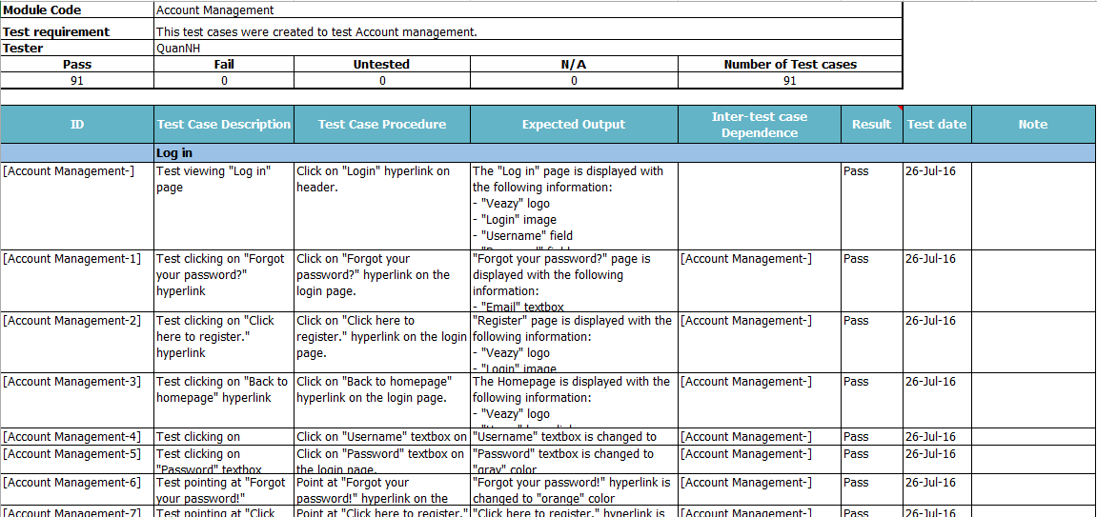
5.2.1 テストのプロセス Test Process
テストケースの実行 Execute test case
品質管理 Quality Control

Slide 55
5.2.1 テストのプロセス Test Process
While executing test, tester detect, log bug and assign to appropriate developer.
1
Create Test Plan
2
Create Test Case
3
Review Test Case
4
Execute Test
5
Log bug
6
Re-test
7
Create Test Report
品質管理 Quality Control

Slide 56
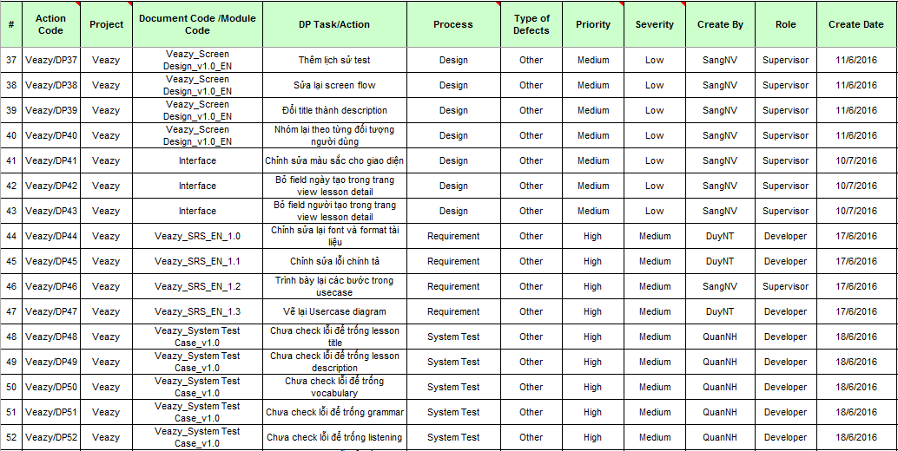
5.2.1 テストのプロセス Test Process
不具合管理 Defect log management
品質管理 Quality Control

Slide 57
5.2.1 テストのプロセス Test Process
When Developer fixed bug, Tester re-test until bug was fixed successfully, then change defect of status to Closed.
1
Create Test Plan
2
Create Test Case
3
Review Test Case
4
Execute Test
5
Log bug
6
Re-test
7
Create Test Report
品質管理 Quality Control

Slide 58
5.2.1 テストのプロセス Test Process
Tester has responsibility to write test report for each test phase. Finish testing phase, Test leader create Test report.
1
Create Test Plan
2
Create Test Case
3
Review Test Case
4
Execute Test
5
Log bug
6
Re-test
7
Create Test Report
品質管理 Quality Control

Slide 59
5.2.1 テストのプロセス Test Process
テストのレポート Test Report
Phase | # Test cases Planned (TC/KLOC) | #Defects Planned (DP/KLOC) | #Test cases Actual (TC/KLOC) | #Defects Actual (DP/KLOC) | % Tests Executed | % Tests Passed | % Tests Fail
Unit Test | 40 | 3-4 | 37 | 0 | 100% | 100% | 0%
Integration Test | 30 | 2-3 | 84 | 2 | 100% | 100% | 0%
System Test | 60 | 1-2 | 643 | 13 | 100% | 100% | 0%
Total | 700 | 6-9 | 764 | 15 | 100% | 100% | 0%
品質管理 Quality Control

Slide 60
5.2.1 テストのプロセス Test Process
テストのレポート Test Report
Phase | Round 1 |  |  |  | Round 2
 | Pass | Fail | Untested | Bug | Pass | Fail | Untested | Bug
Unit Test | 37 | 0 | 0 | 0 | 37 | 0 | 0 | 0
Integration Test | 79 | 2 | 3 | 2 | 84 | 0 | 0 | 0
System Test | 618 | 5 | 20 | 13 | 643 | 0 | 0 | 0
Total | 734 | 7 | 23 | 15 | 764 | 0 | 0 | 0
品質管理 Quality Control

Slide 61
5.2.1 テストのプロセス Test Process
テストのレポート Test Report
Defects | Logged | %Closed | %Invalid | %Open
Critical | 0 | 0% | 0% | 0%
High | 0 | 0% | 0% | 0%
Medium | 9 | 100% | 0% | 0%
Low | 6 | 100% | 0% | 0%
Total | 15 | 100% | 0% | 0%
品質管理 Quality Control

Slide 62

プロジェクト結果 Project Result

Slide 63
6. プロジェクト結果 Project Result
Main objective | This website provides Vietnamese studying for Japanese people.
Source repository | https://github.com/sangnvus/201605JS01
 | Plan | Actual
Start date | 09/05/2016 | 09/05/2016
End date | 24/08/2016 | 01/09/2016
Release versions | 1.0 | 1.0
Duration | 75 days | 84 days
Efforts (person day) | 450 | 504
Test cases | 700 | 764
Defects | 150-200 | 121
Lines of code | ~12000 | ~15000

Slide 64
6. プロジェクト結果 Project Result
知識 Knowledge
Working process of FPT Software to develop a project.
Putting the learned knowledge into practice.
Technical: Java, SpringMVC, Hibernate, AngularJS Framework, Bootstrap.
Tools: Git, Trello, Astah, Maven, PostgreSQL, Sublime Text, Office tools.

Slide 65
6. プロジェクト結果 Project Result
将来 に 期待 Expectation in Future
Login with Google+, Facebook, Twister.
Expand server to increase number of users.
Commercialized product.
Create mini game, dictionary function in website to additional support for learning Vietnamese.
Support more popular language.
Better support on the phone.

Slide 66
6. プロジェクト結果 Project Result
学んだ教訓 Lessons Learnt
Working in group and working individual.
Be open to get the better opinions from other member.
Manage time and make the plan.
Limit and resolve conflicts between members.
Improve coding skill with new technology and writting document skill.

Slide 67

7. デモ Demo

Slide 68

8. 質問と回答 Q & A

Slide 69

Notes:
You can safely remove this slide. This slide design was provided by SlideModel.com – You can download more templates, shapes and elements for PowerPoint from http://slidemodel.com

